Slide 1
Shell Bootcamp 2024 3 Reflections for Week #1
Mahendra Kumar
Date : 30-Aug-2024

Slide 2

About Me
Dedication for improvement is what makes you perfect.

Slide 3

My learnings from this week!

Slide 4

Learning 1 | My takeaways
Professionalism is one of the most important pillar of corporate world.
Building the right attitude.
Grooming and meeting etiquettes.
Do’s and don’ts of professional e-mail.
Professionalism in energy sector enhances operational efficiency and safety by adhering to industry standards and regulations. It fosters ethical behavior and transparency, building trust with stakeholders and public.

Slide 5
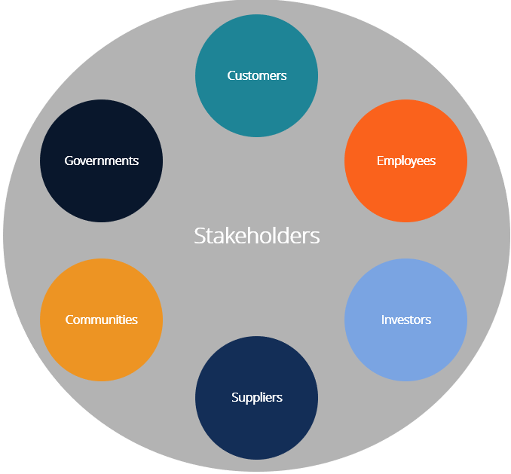
Learning 2 | My takeaways
Stakeholder Analysis
Identify the stakeholder
Understand Stakeholder
Prioritize stakeholder
Develop a communication plan
Manage and monitor stakeholder expectation
Always have power-interest graph in mind
Stakeholder expectation
Transparency
Giving everyone significant amount of say
Physical interaction is best but if it is not possible, you can have another mutually acceptable channel

Slide 6
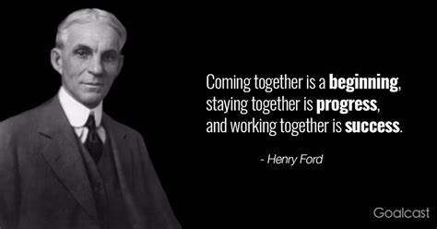
Learning 3 | My takeaways
Benefits of Teamwork
Encourages personal growth and Increases job satisfaction
Reduces stress Increases efficiency by sharing the workload
Boosts accountability and morale
Stages of Development (Tuckman Model)
Performing
Forming
Storming
Norming
Sandwich feedback method should be used

Slide 7

Relevance of learnings for my organization

Slide 8

Learning 1 | Relevance for Shell
How I feel Shell implements this learning:
Training program
Leadership by example
Performance evaluation
Clear Communication
How I feel Shell benefits from this learning:
Enhanced Reputation
Employee Satisfaction
Risk Mitigation

Slide 9
Learning 2 | Relevance for Shell
How I feel Shell implements this learning:
Stakeholder Mapping
Communication Plan
Feedback mechanism
Collaborative platform
How I feel Shell benefits from this learning:
Improved Decision-Making
Risk mitigation
Strengthened Relationship
[Add a graphic that provides view of how Shell implements this learning]

Slide 10
Learning 3 | Relevance for Shell
How I feel Shell implements this learning:
Team building Activities
Cross-Functional Team
Clear Roles and Responsibilities
Recognition and Reward
How I feel Shell benefits from this learning:
Increased Innovation
Higher Productivity
Employee Engagement
[Add a graphic that provides view of how Shell implements this learning]

Slide 11

Challenges in implementing learning

Slide 12

Challenge faced while implementing Learning 1
Challenge faced while implementing:
Cultural Resistance
Consistency across Regions
Measurement and Accountability
Time Constraints

Slide 13
Challenge faced while implementing Learning 2
Challenge faced while implementing:
Diverse Stakeholder interest
Communication barriers
Resource Allocation
[Add a graphic that provides evidence of what you did to overcome this challenge]

Slide 14
Challenge faced while implementing Learning 3
Challenge faced while implementing:
Geographical Dispersion
Diverse Work Cultures leading to misunderstanding sometimes
Role Clarity Issues
Resistance to change
[Add a graphic that provides evidence of what you did to overcome this challenge]

Slide 15

Action Plan

Slide 16
My Action Plan for this Week
Actions
Timeline
Status
Learning more about Azure DevOps
Setting up PostgreSQL and working on that
Making more friends
1 Week
Ongoing

Slide 17

Learning is also Fun!

Slide 18

Summary
Professionalism: We learned the importance of consistent behavior and clear communication, though adapting these standards globally and measuring their impact was challenging.
Stakeholder Management: Managing diverse stakeholder needs improved our collaboration but balancing conflicting interests and overcoming communication barriers required significant effort.
Teamwork: Enhancing teamwork boosted innovation and productivity but bridging geographical and cultural gaps was a challenging part of the journey.

Slide 19
Thank You

